Slide 1

Credit Risk Model Analysis & Insights Data-Driven Decision Making Yasir Keskin

Slide 2
Executive Summary
Objective: Develop a predictive model to assess credit risk for loan applicants.
Key Actions: Data cleaning, feature engineering, and model training using LightGBM.
Key Findings: The model achieved a high accuracy of 92.98% with a ROC AUC score of 96.94%.
Business Impact: Improved loan approval efficiency and reduced financial risk through proactive alerts.
Identifying credit risk in loan applicants is crucial for minimizing financial losses.
Our goal was to create a predictive model that helps approve loans more efficiently and accurately

Slide 3

Introduction to the Problem
Challenge: Identifying credit risk for loan applicants.
Impact: Minimize financial losses, enhance loan approval efficiency.
Goal: Develop a data-driven model for risk prediction.

Slide 4

Data Overview
Datasets Used:
Loan Data: (40,000 records, 9 columns) Information about loan reasons, terms, and requested amounts.
Customer Data: (40,000 records, 9 columns) Demographic details like gender, employment, and postal code.
Customer Financials: (1.3M records, 6 columns) Salary, account balances, and credit card balances.
Loan Delinquencies: (15,285 records, 3 columns) Data on delinquent loans with start and end dates.
Key Features: Loan terms, requested amounts, salary, balances, and delinquency history.

Slide 5

Data Preparation & Cleaning
Steps Taken:
Handled missing values using median and zero imputation for numerical and categorical data.
Converted date columns from object to datetime format for accurate temporal analysis.
Managed negative balances and outliers to avoid data skewness.
Outcome: Data is complete and properly formatted for modeling.

Slide 6

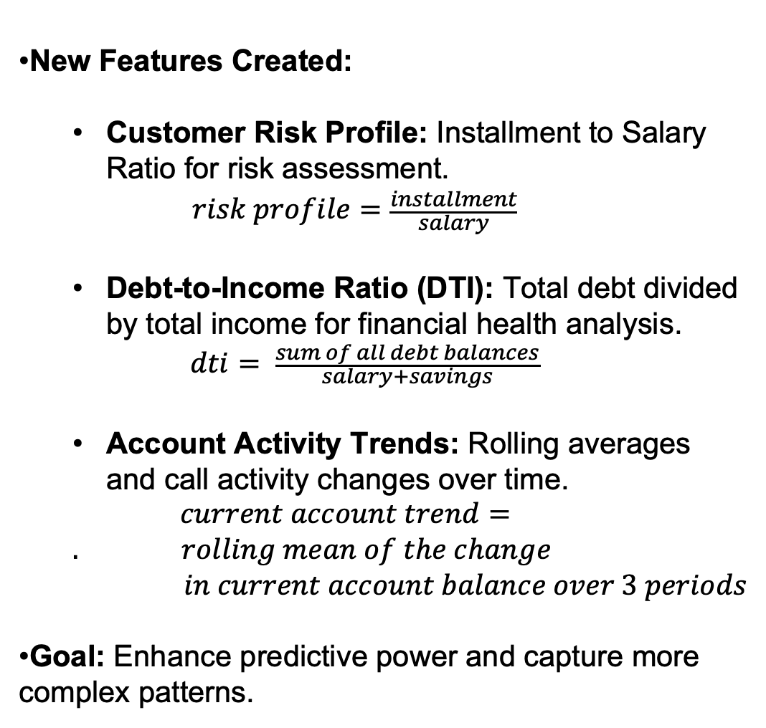
Feature Engineering
New Features Created:
Customer Risk Profile: Installment to Salary Ratio for risk assessment.
$$risk profile=\frac{installment}{salary}$$
Debt-to-Income Ratio (DTI): Total debt divided by total income for financial health analysis.
$$dti= \frac{sum of all debt balances}{salary+savings}$$
Account Activity Trends: Rolling averages and call activity changes over time.
$current account trend=. rolling mean of the change$
$$in current account balance over 3 periods$$
Goal: Enhance predictive power and capture more complex patterns.

Slide 7

Model Selection & Training
Algorithm Used: LightGBM Classifier for high performance on imbalanced dataset.
Key Steps:
Data Splitting (Train-Test 80/20): Balanced dataset for training and evaluation.
Hyperparameter Tuning using Cross-Validation: Optimal settings for model performance.
Feature Scaling and One-Hot Encoding: Standardization and categorical encoding.

Slide 8

Model Performance
Metrics Achieved:
Accuracy: 92.98% (Overall correctness)
Precision: 82.52% (True positive rate)
Recall: 80.03% (Correct positive identification)
F1 Score: 81.25% (Balance between precision and recall)
ROC AUC: 96.94% (Overall discrimination power)
Interpretation: The model shows strong performance across all metrics, with a good balance between false positives and false negatives.

Slide 9
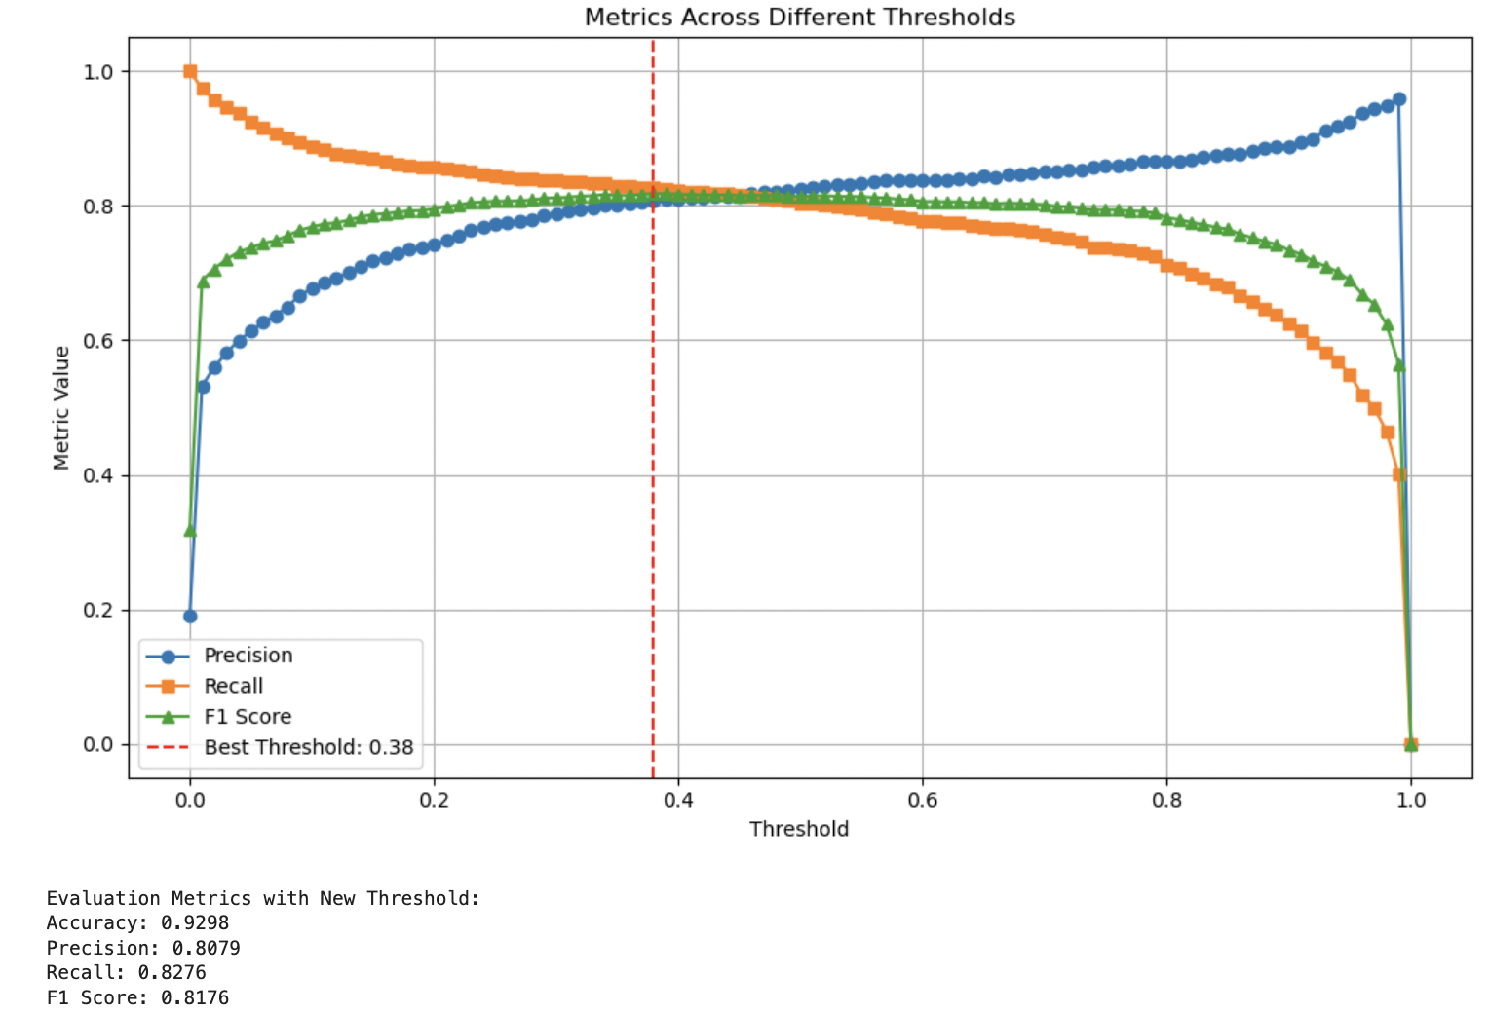
Threshold Detecting for Best Metrics

Slide 10

Feature Importance & SHAP Analysis
Top Contributing Features:
Current Account Balance and Trend: Strong predictor of risk.
Salary: Indicator of repayment capability.
Saving Account Balance: Additional financial buffer.
Installment Amount: Direct correlation with loan size.
SHAP Insights:
"Number of Calls from ING" correlates strongly with higher risk.
Visual analysis showed a direct link between financial activity and risk scores.

Slide 11
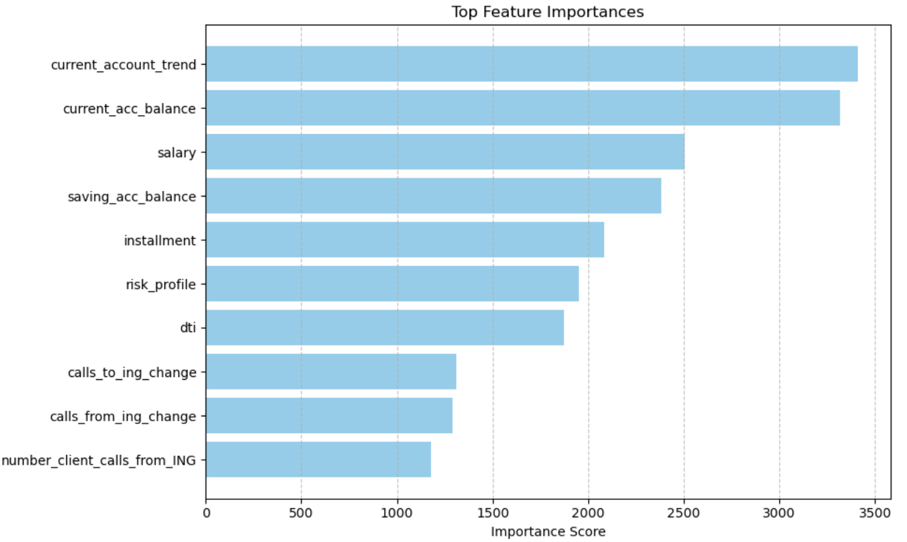
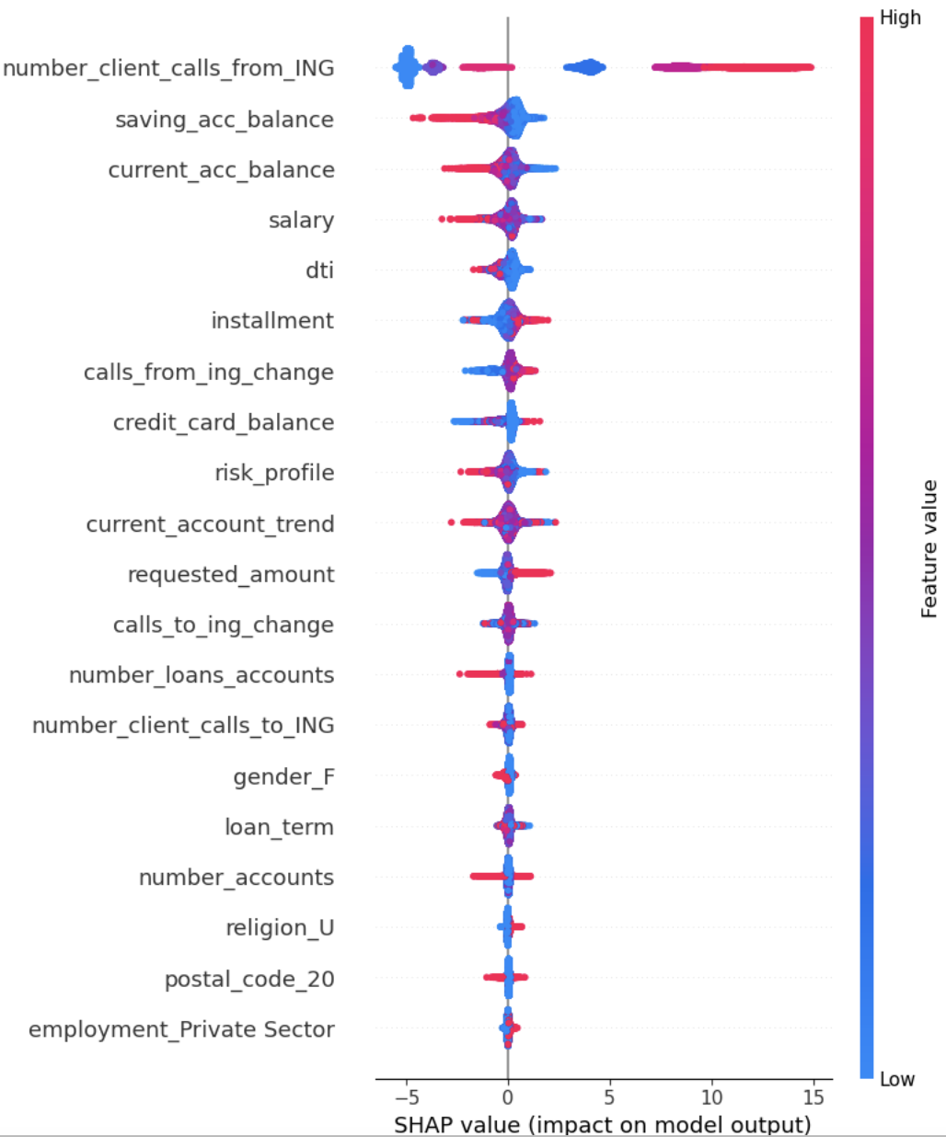
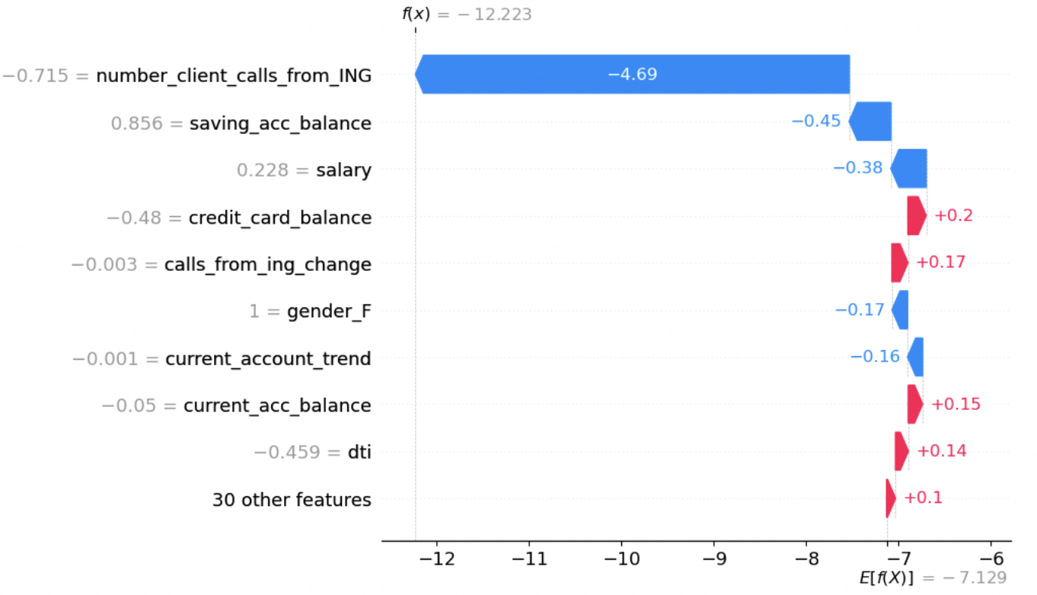
SHAP and Feature Importance Plots

Slide 12

Business Impact & Recommendations
Key Insights:
High delinquency risk is linked with frequent client calls and low balances.
Current account balance, salary and balance metrics are critical predictors.
Recommendations:
Implement proactive risk alerts for high call activity.
Leverage risk scores for automated loan approvals and early interventions.

Slide 13

Conclusion & Next Steps
Summary:
LightGBM successfully predicted credit risk with high accuracy.
Balanced performance metrics suitable for deployment.
Next Steps:
Deploy the model in a controlled test environment.
Continuously monitor performance on live data for adjustments.

Slide 14
Thank You!

